Slide 1
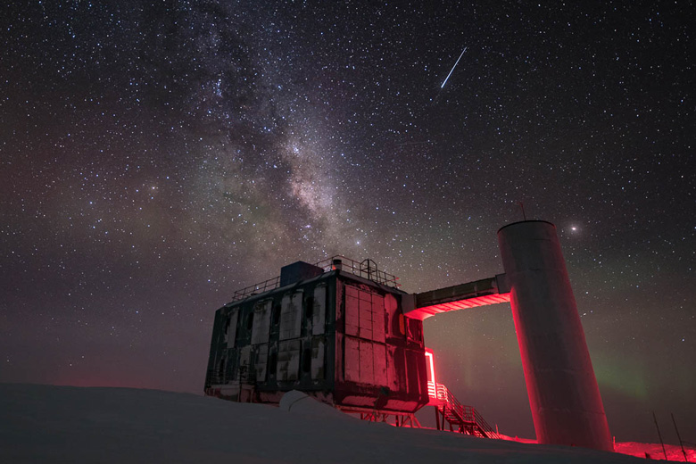
The IceCube Neutrino Observatory: The Perfect Muon Detector Unraveling Cosmic Secrets
Pascal Gutjahr
TU Dortmund University
pascal.gutjahr@tu-dortmund.de
LPC – Clermont-Ferrand
06.10.2023
icecube..wisc.edu

Slide 2
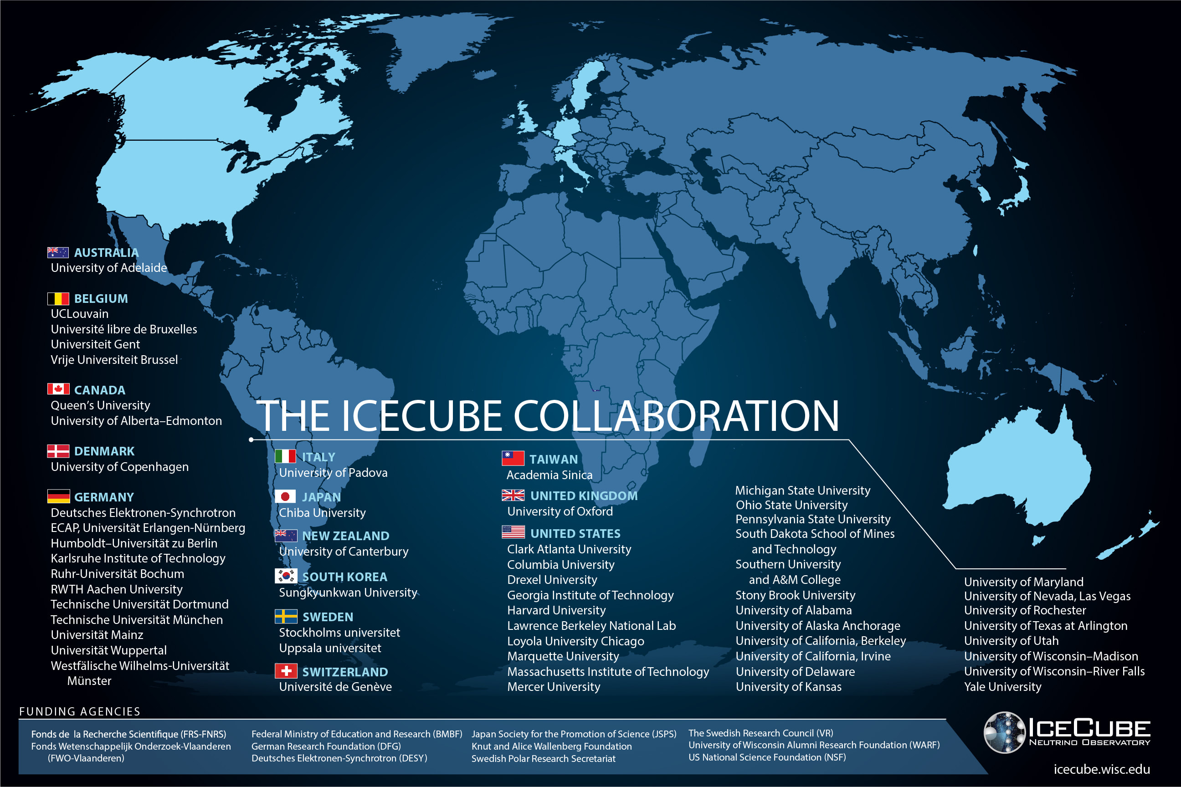

Slide 3
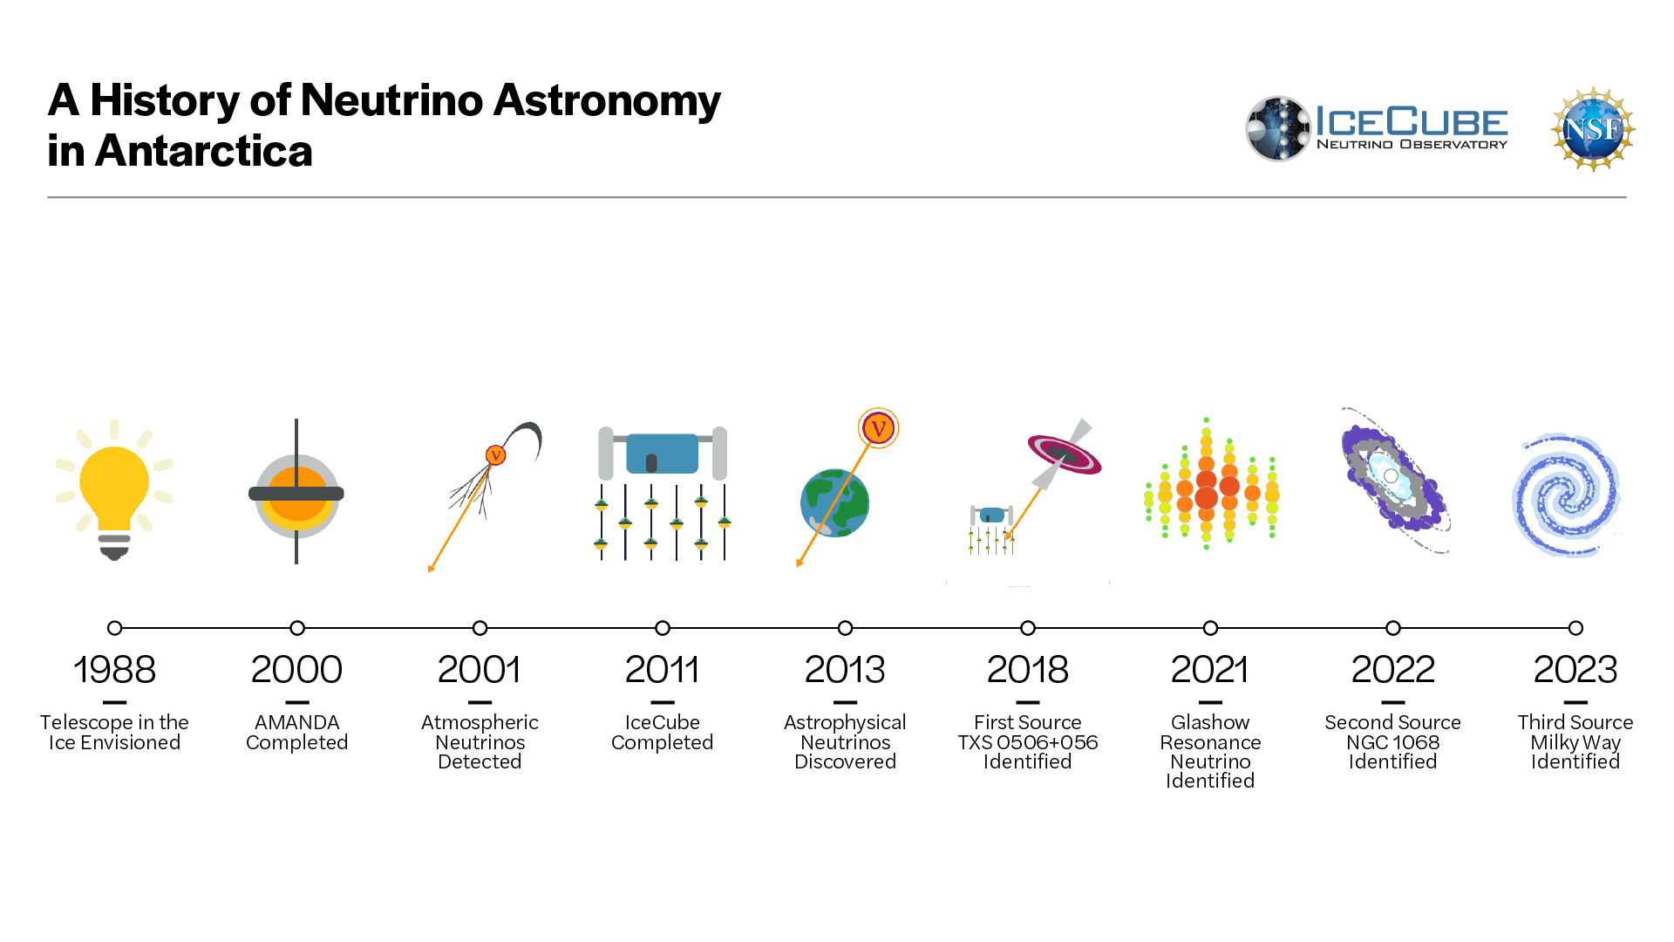

Slide 4
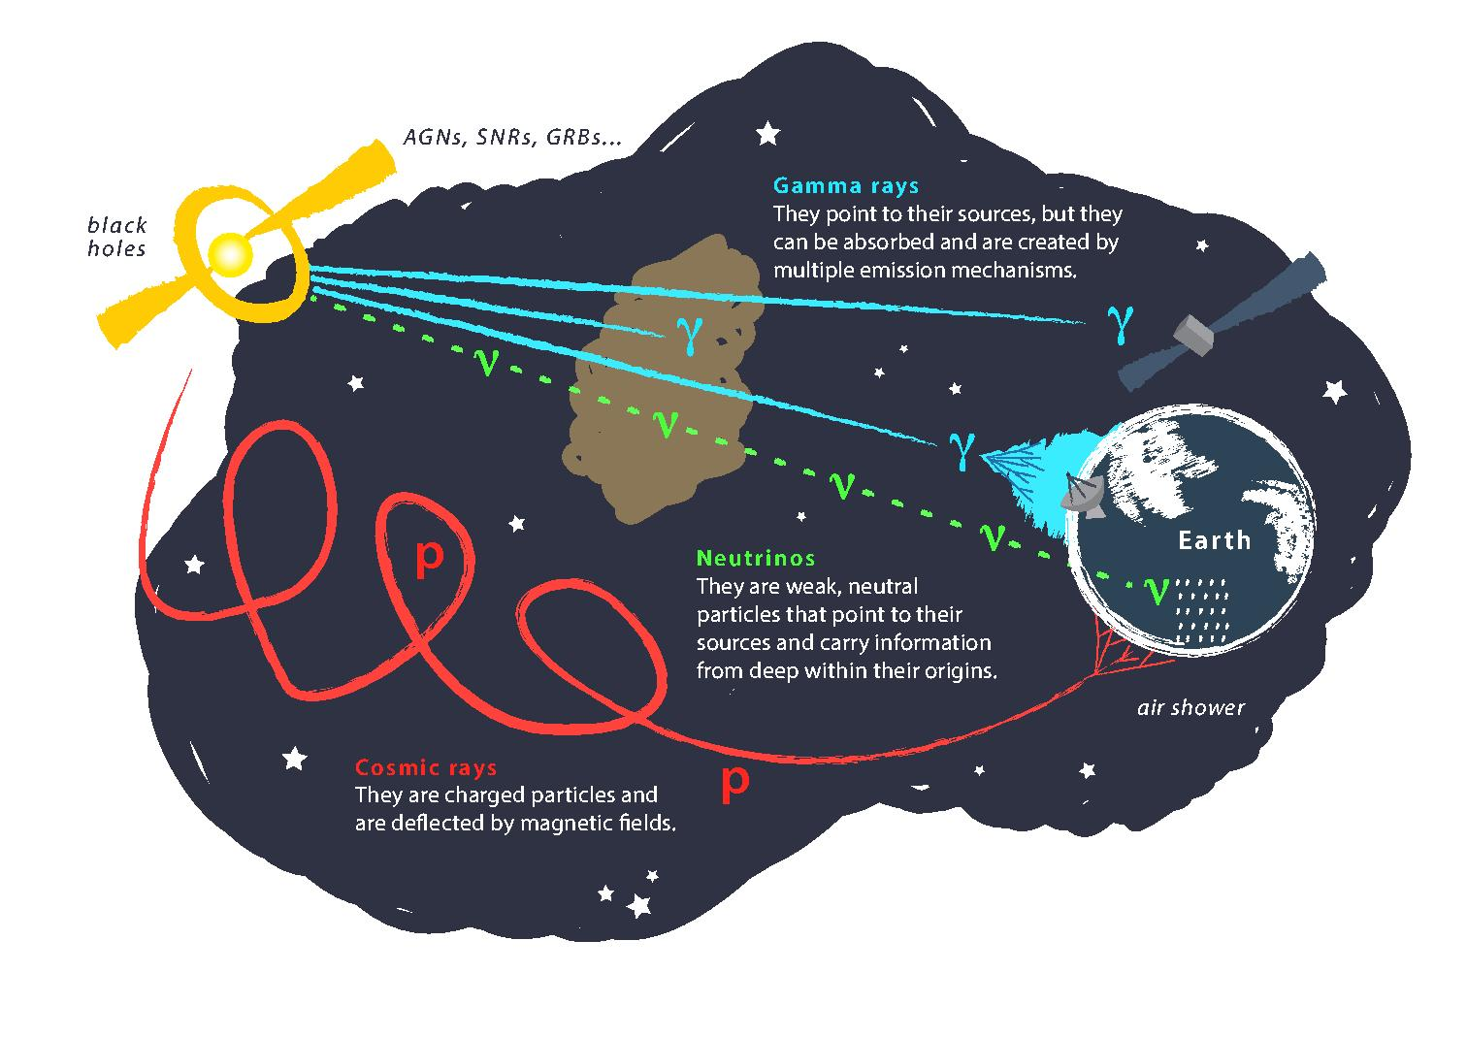
Astroparticle Physics
gallery.icecube..wisc.edu

Slide 5
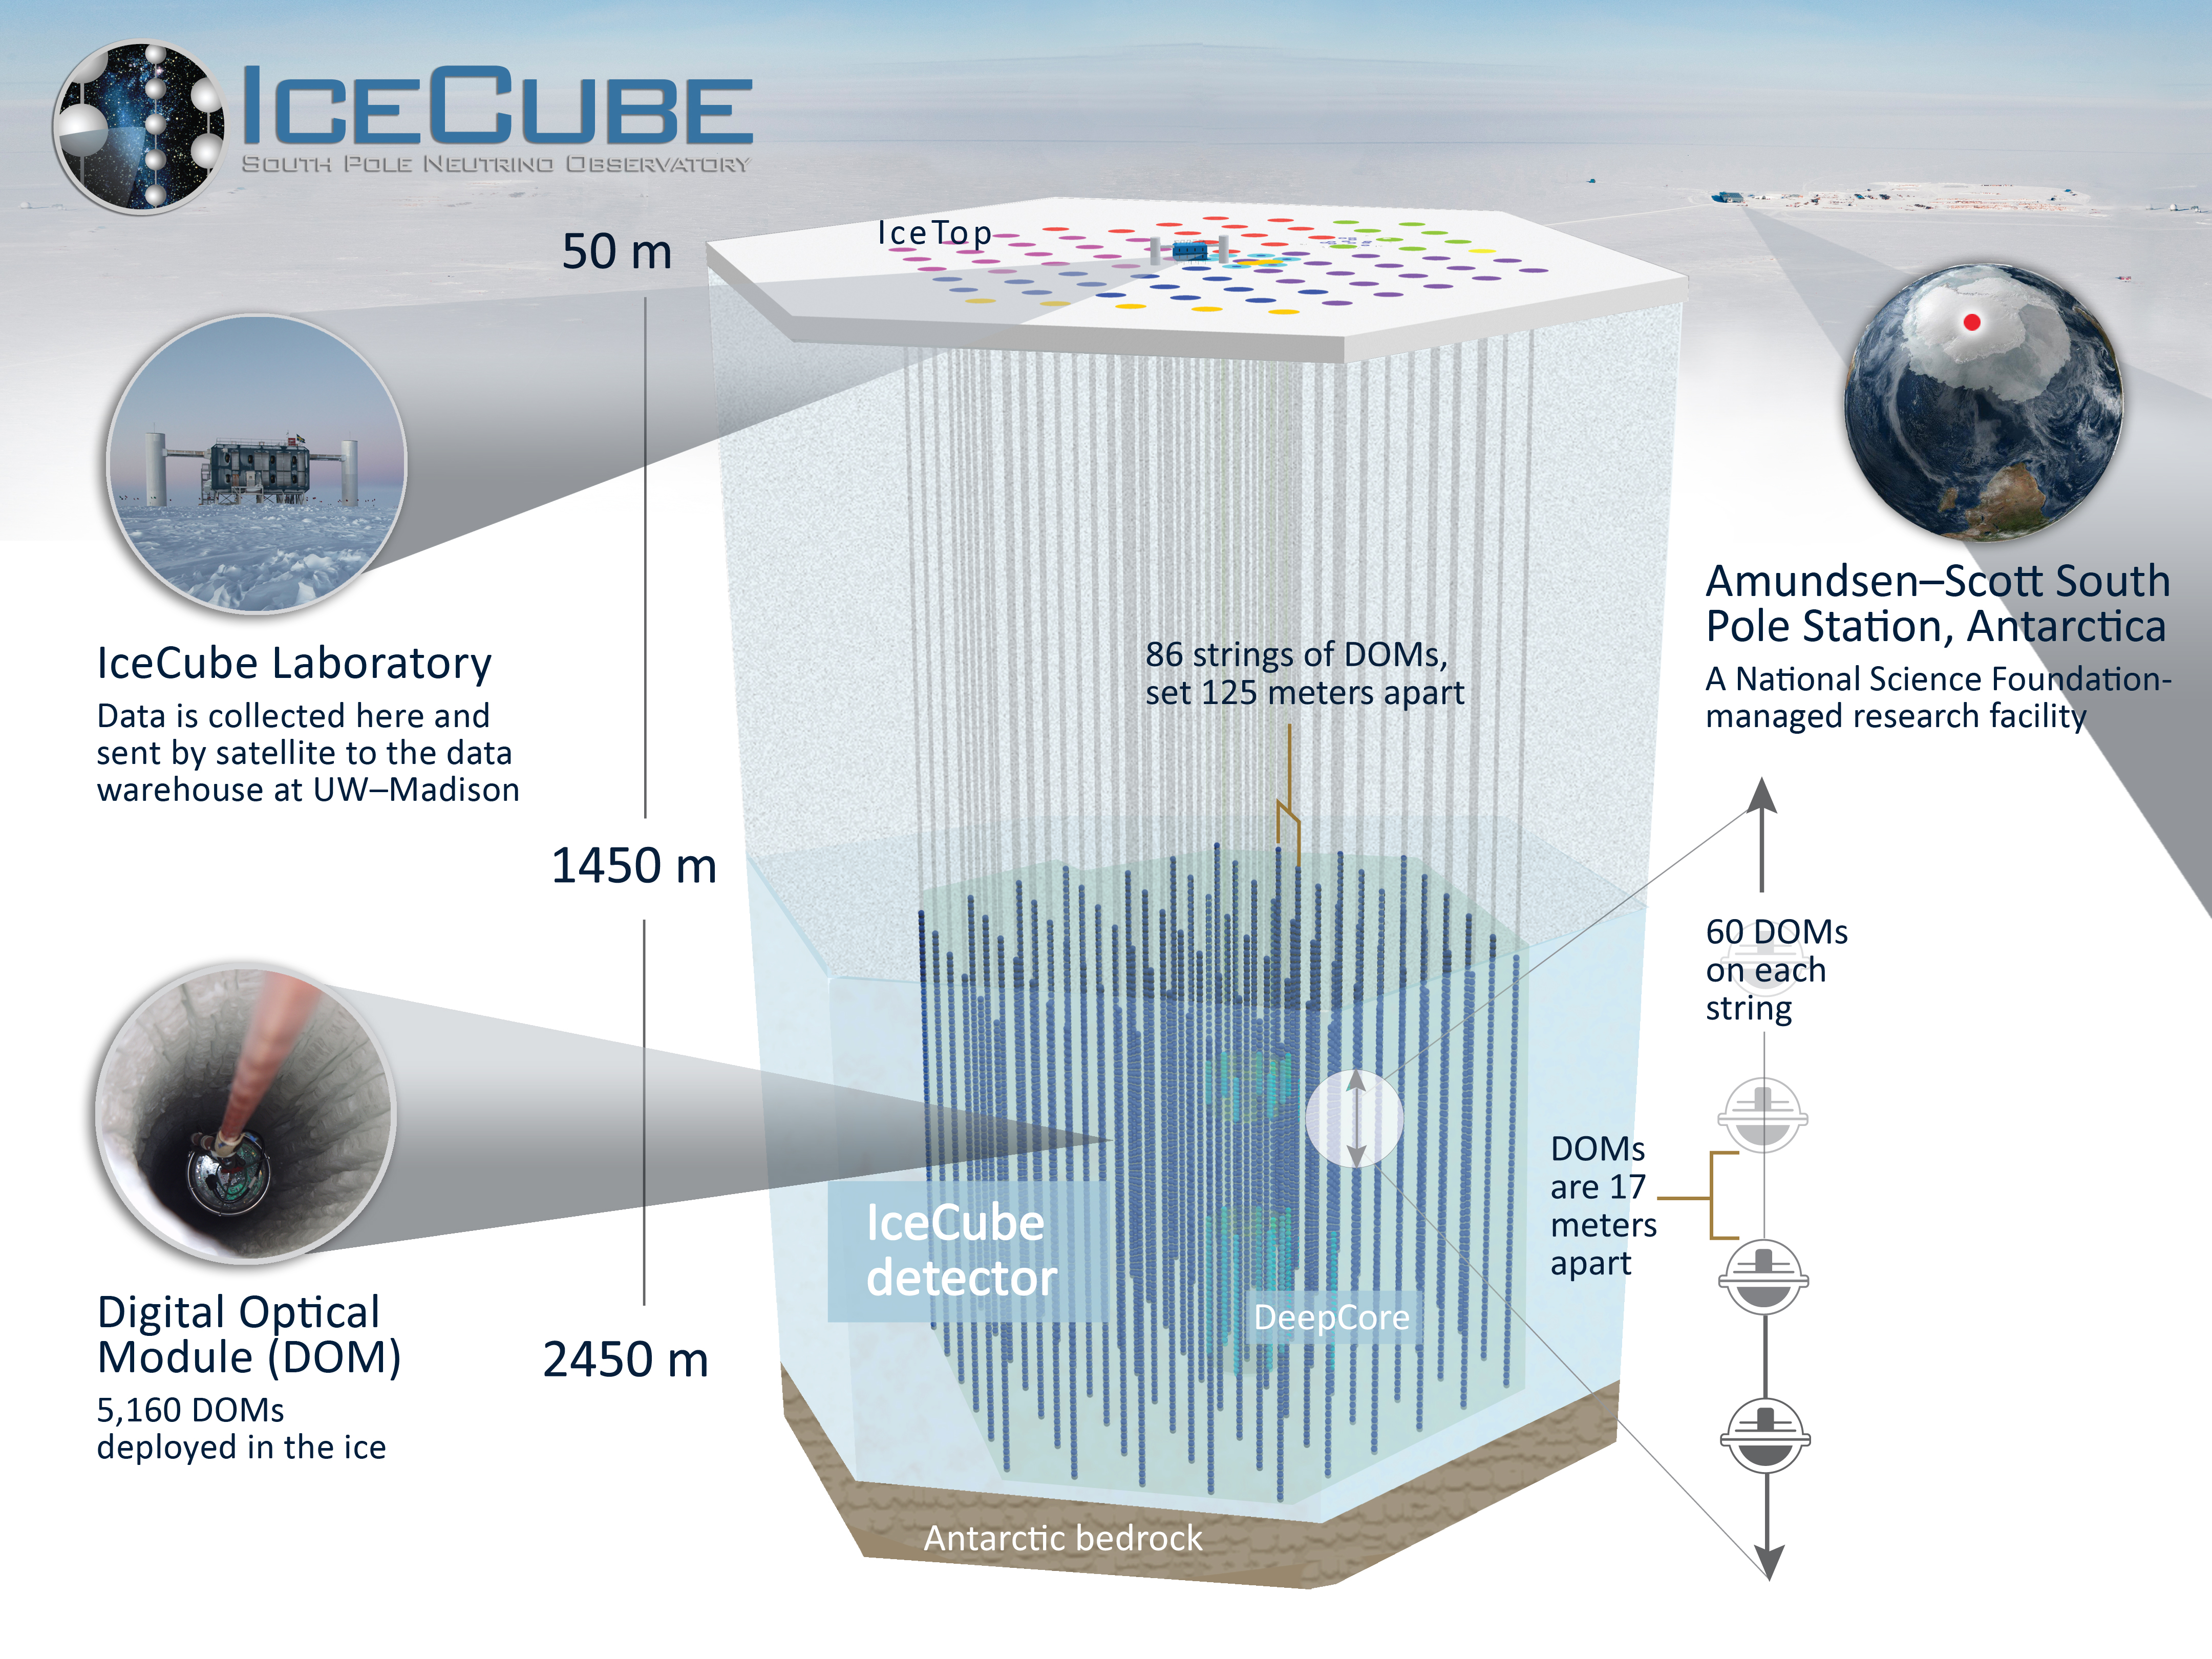
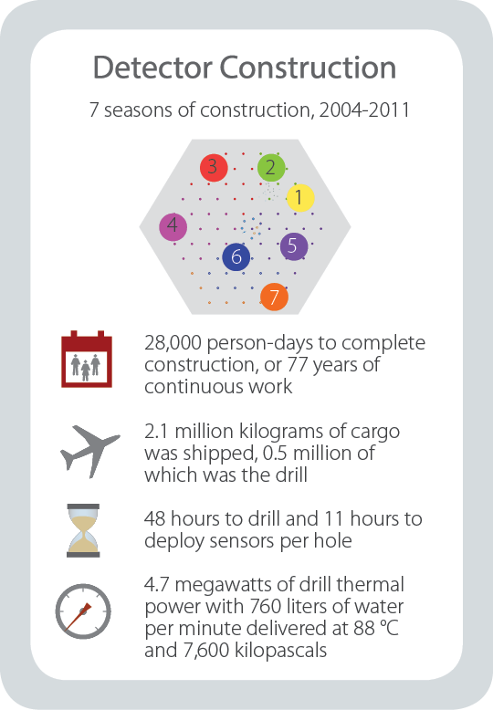
gallery.icecube..wisc.edu

Slide 6
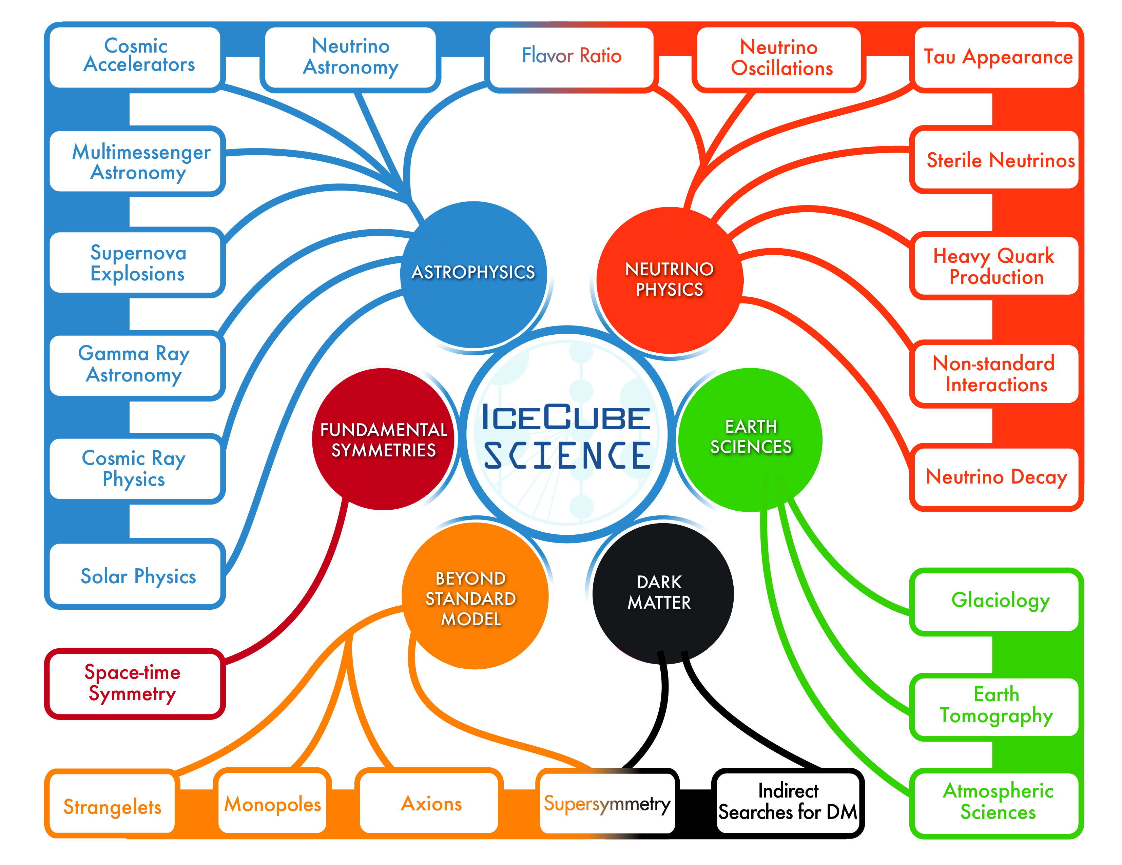
gallery.icecube..wisc.edu

Slide 7
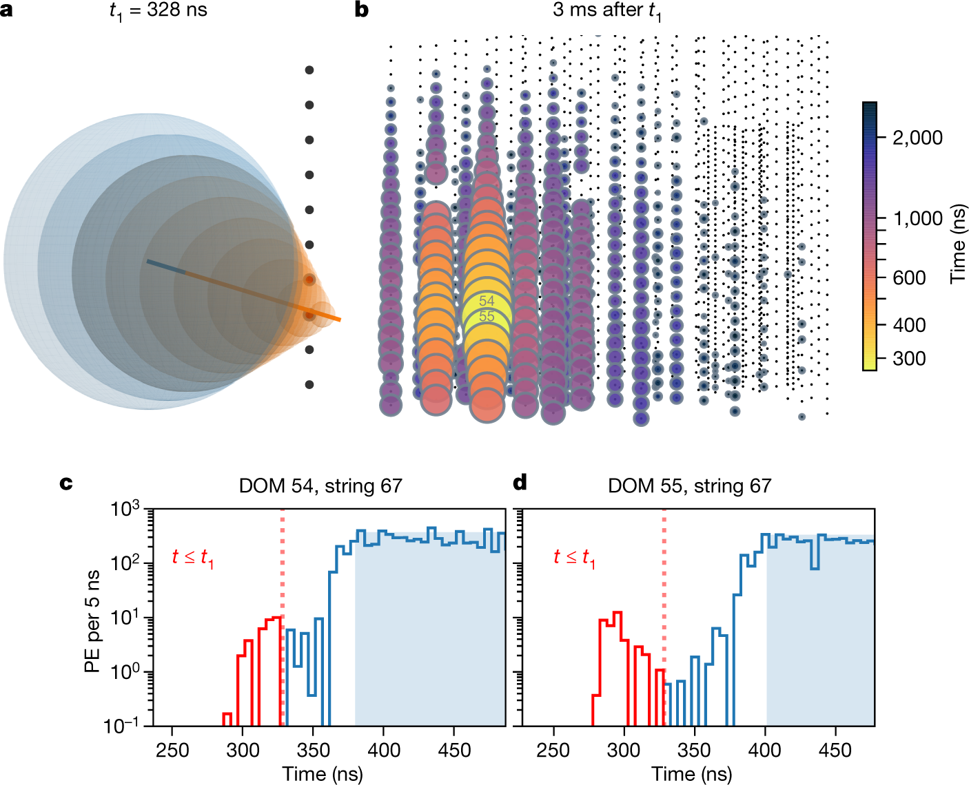
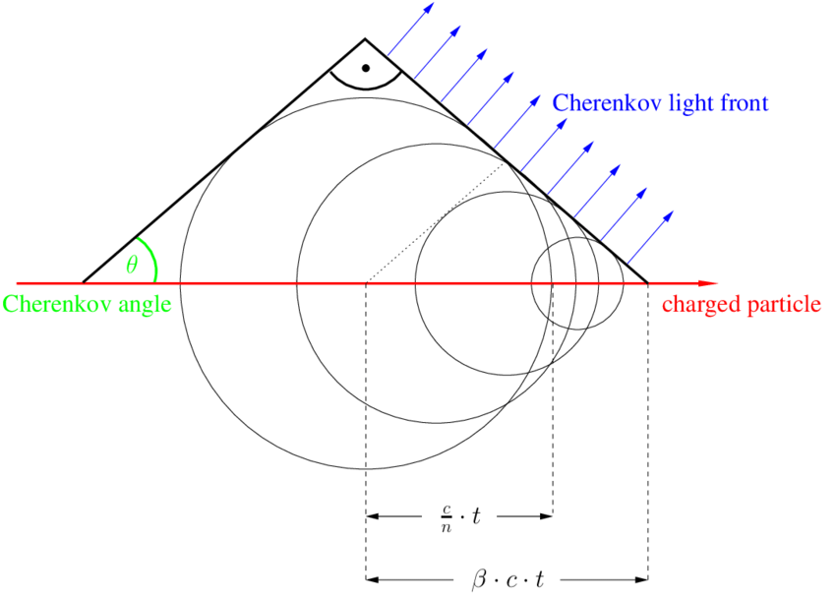
Particle Detection – Cherenkov Light
10.1038/s41586-021-03256-1
T. Gluesenkamp

Slide 8
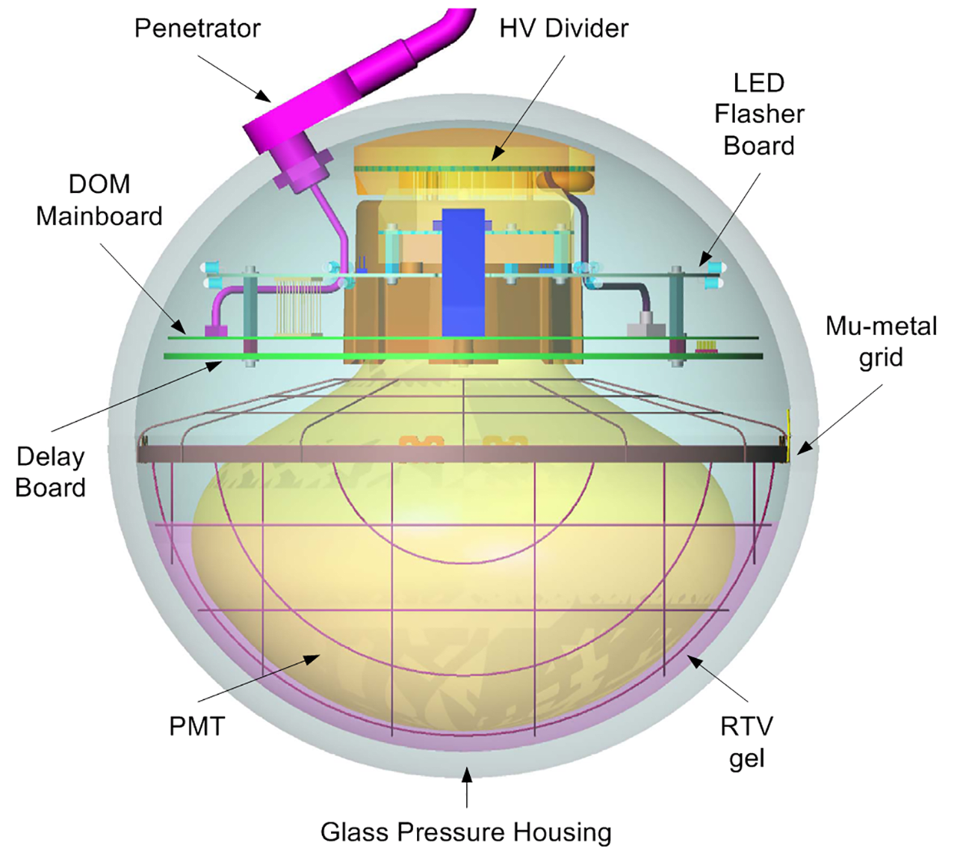
Digital Optical Module (DOM)
icecube..wisc.edu

Slide 9
Detection medium - ice

Slide 10
Event types – mu, e, tau

Slide 11
Air shower - principle

Slide 12
More background

Slide 13
Seasonal variations

Slide 14
Earth as shield

Slide 15
muon deflections

Slide 16
NGC 1068

Slide 17
TXS

Slide 18
Galactic plane

Slide 19
muon puzzle - observation

Slide 20
Connection to LHC

Slide 21
possible solutions

Slide 22
prompt muons

Slide 23
!! Check icecube’s homepage, there are some quick facts and stuff like that

Slide 24
IceCube Upgrade

Slide 25
IceCube Gen-2

Slide 26
Multimessenger – include IceTop etc.

